Slide 1
Flask API

Slide 2
API (Application programing interface)
Used as an interface by software components to communicate with each other.

Slide 3
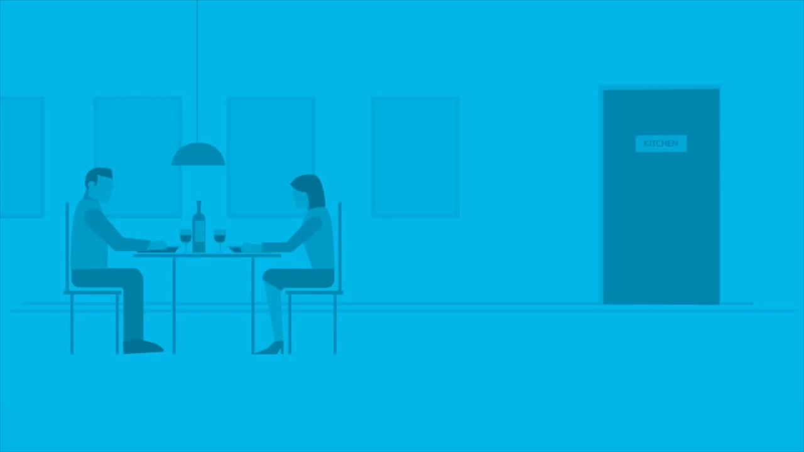

Slide 4
Frameworks
Django
Flask
CherryPy

Slide 5
Why Flask?
Flask
Micro Framework written in Python for the web
Micro meaning simple core but highly extensible
Used to create websites and API’s
Easy to learn
Pythonic
Import only what you need
Flask won’t make any decisions for you, such as what database to use
Small but can easily handle large apps
Testable

Slide 6
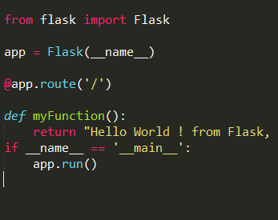
Toy EXAMPLE

Slide 7
Imports
from flask import Flask
flask-Library
Flask-Module

Slide 8
Application object
app = Flask(__name__)
app: Application object is the instance of Flask class which enables us to run the flask application
__name__: Checks to see if this module was called interactively and then calls the specified function to execute the code.

Slide 9
Decorator
@app.route(“/”)
@ is the decorator which is a function that takes another function and extends the behavior of latter function without explicitly modifying it.
By having app.route as a decorator, the function below the decorator is registered for the route. So that when the route is requested, below function is called.

Slide 10
Function
def myFunction():
return “Hello World ! from Flask”

Slide 11
Run APP object
If __name__ == “__main__”:
app.run()
Python interpreter sets a few special variables like __name__
Which executes all the code present in this block.

Slide 12
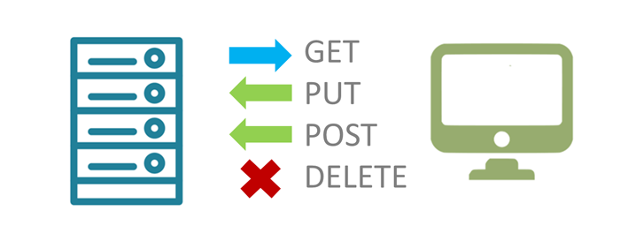
REST/REstful API
Representational State Transform.
Architectural principle that advocates use of HTTP.
Resources being manipulated using CRUD(Create, Retrieve, Update, Delete) becomes POST, GET, PUT, DELETE.

Slide 13
JSON
JavaScript Object Notation
Lightweight format
Used for data interchanging
Example: {“Name”:Value}

Slide 14
JSON vs Dict
JSON is a pure string written in a convention format, which does not have any characteristics of data structure.
The dict itself is a complete data structure that implements all of its own algorithms.
Python's dictionary key can be any hash object, and JSON can only be a string.

Slide 15
GET
GET is used to request data from a specified resource.
In GET method the data is sent as URL parameters that are usually strings of name and value pairs separated by ampersands (&). In general, a URL with GET data will look like this:
http://www.example.com/action.php?name=john&age=24

Slide 16
POST
In POST method the data is sent to the server as a package in a separate communication with the processing script.
Data sent through POST method will not visible in the URL.

Slide 17
PUT
The PUT method completely replaces whatever currently exists at the target URL with something else.
With this method, you can create a new resource or overwrite an existing one

Slide 18
DELETE
It is used to delete a resource identified by a URI.

Slide 19
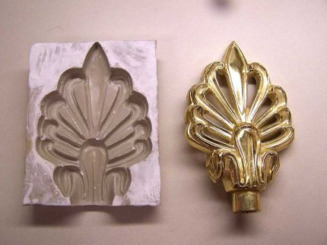
BluePrints
A blueprint is a template for generating a "section" of a web application. You can think of it as a mold
Take the blueprint and apply it to the application in several places. Each time you apply it the blueprint will create a new version of its structure in the plaster of the application.

Slide 20
POSTMAN - WORKING

